Slide 1
Inclusion is belonging
Pitch Brief
Health Services
August 2021
Notes:
Robotica’s Access Services provides improved access to video content for people who are deaf or hard of hearing.
It is easy to take for granted all the written and spoken language use we encounter every day. For 150,000 deaf people in the United Kingdom, BSL is their first or preferred language, the language of their internal monologue. It has never previously been feasible to make the world of information, available in visual languages, but this is a situation we will change.

Slide 2



The EDI challenge
1 million
Don’t understand English
1 in 6
Have hearing loss
150 000
BSL Households
Notes:
1 million people in the UK – 2% - cannot speak English well or a all. And those with poor English are disproportionately likely to suffer from ill health (source: ons.gov.uk)
12 million adults in the UK – 1 in 6 people - have hearing loss and for almost one million of those, their hearing impairment is severe or profound (source: RNID).
There are 150,000 households in the UK where at least one member relies on BSL as their first or only language (source: RNID)

Slide 3

Cassie for Health Services
When your first responsibility is the care of patients, acting efficiently to help patients and those who accompany them is essential. Digital assistants like Cassie offer a means of signposting and support for visitors without distracting or occupying busy healthcare professionals with frequently asked questions, ensuring that those members of staff are more available when they are directly needed.
Cassie seamlessly and precisely connects people to the information they need and shares those conversations back to you as actionable insights, supporting your desire to maximise your service proposition.

Slide 4
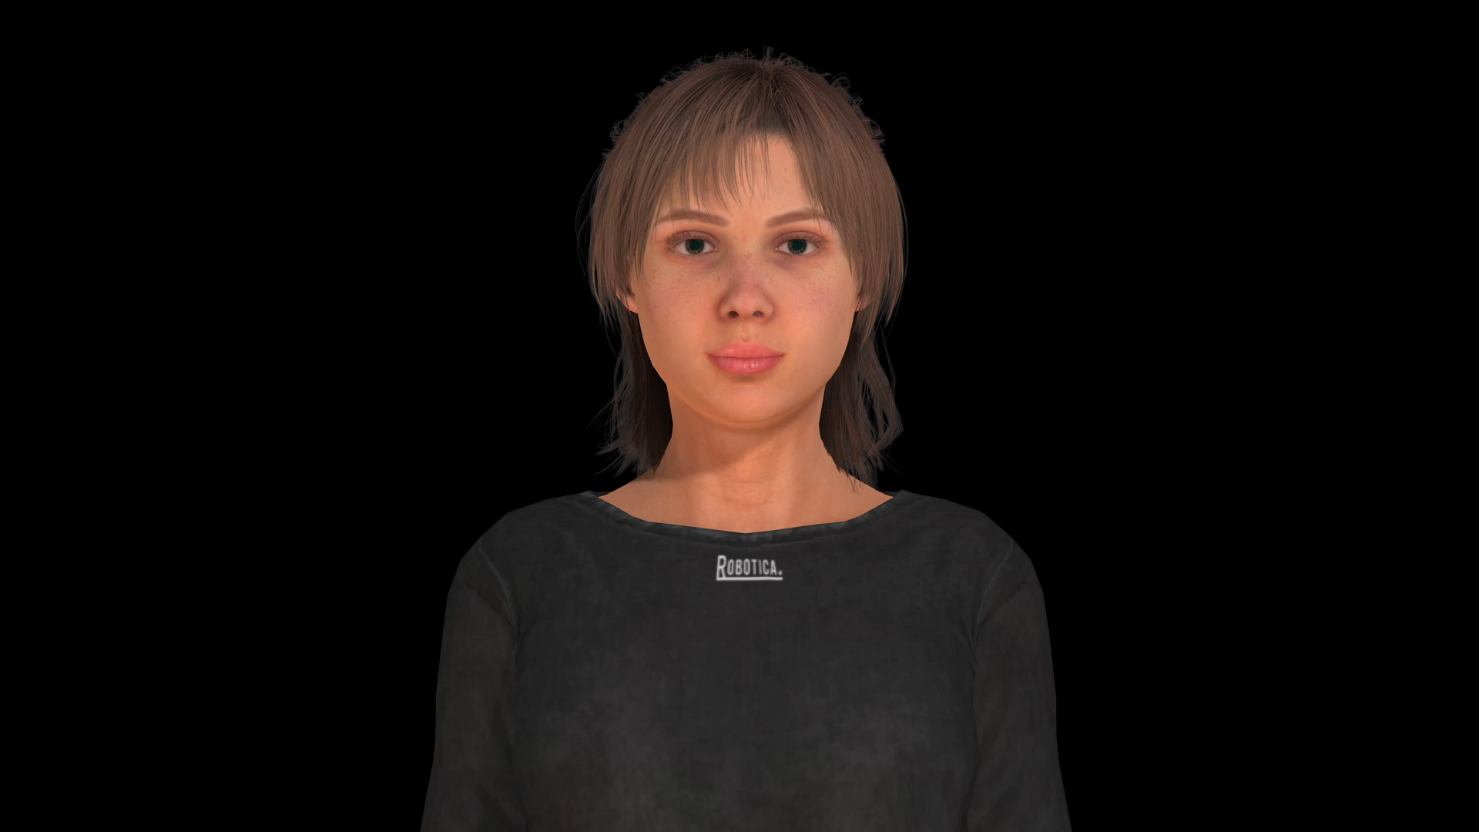
Welcome visitors in every language
All visitors to your facilities need to feel welcomed and reassured that they will be cared for. Greeting them in their own language makes a strong first impression.
Cassie can understand and translate between 20 spoken languages and your information and content can even be offered in sign languages, including British Sign Language, American Sign Language, Langue des Signes Française, and Cued Speech. With this, those people who need to visit your establishment can feel included and even more welcome, and patient flow is improved.

Slide 5
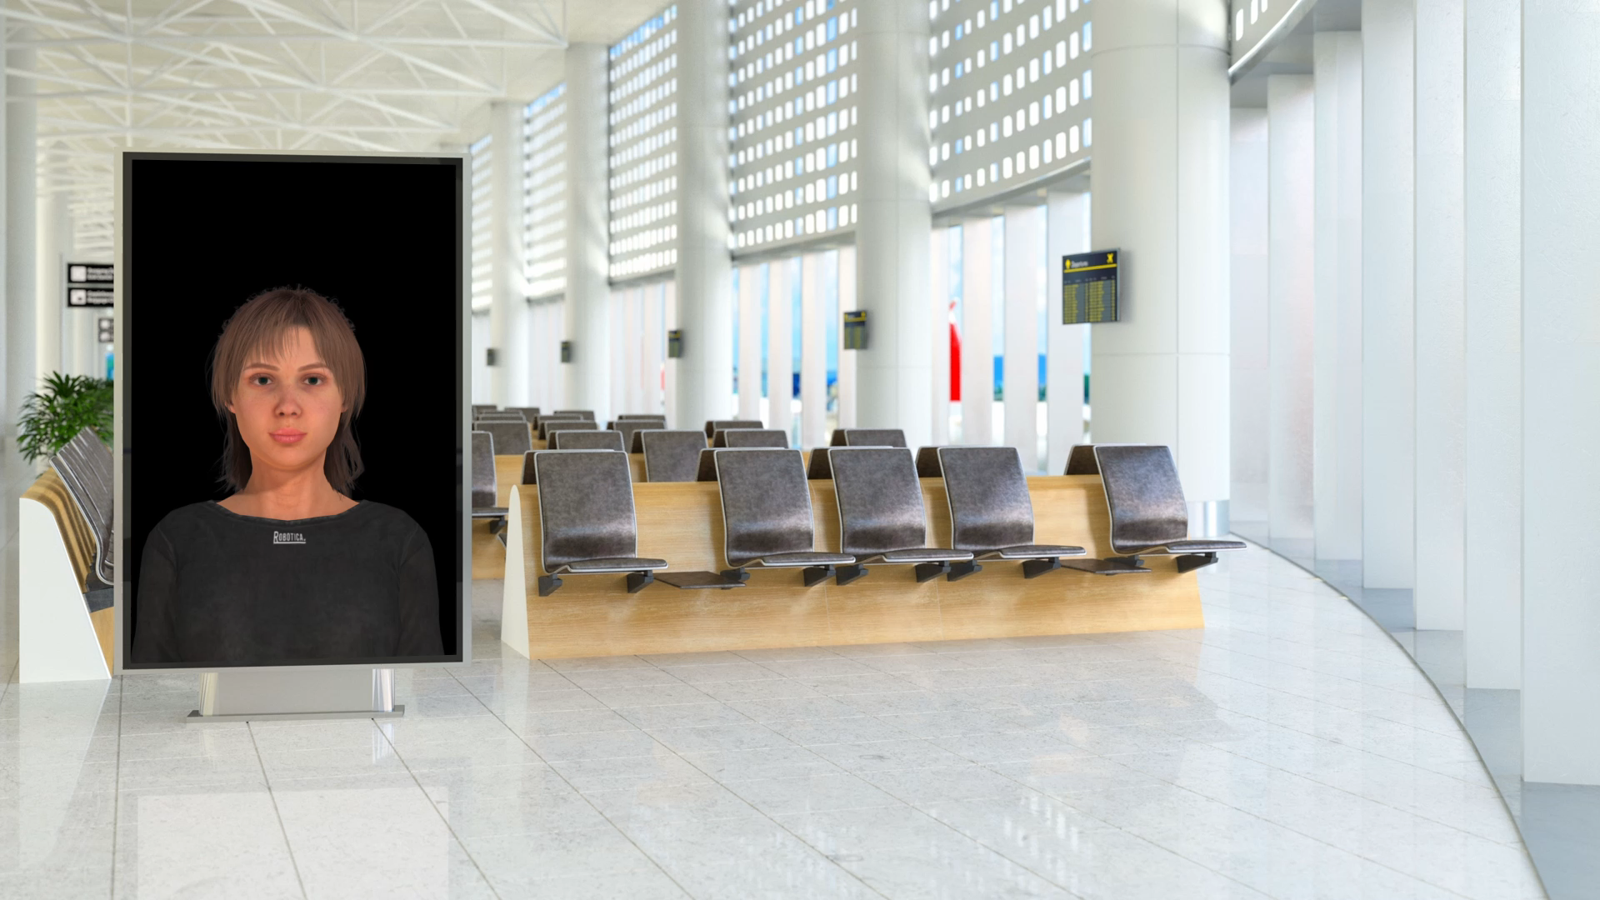
Know your visitors
How well do you know the visitors to your facilities? Do they understand your services?
"Last week, 16 visitors asked about diabetes, in Korean."
Insights like this are actionable intelligence - hard facts which can tell you about your current visitors and those who accompany them to your healthcare service.
Every conversation with Cassie helps her to comprehend individual visitors and visitor patterns, to construct an accurate picture of the health service environment. Cassie learns the world around her, draws meaning from the interactions and creates detailed reports describing what visitors really want to know.

